Slide 1
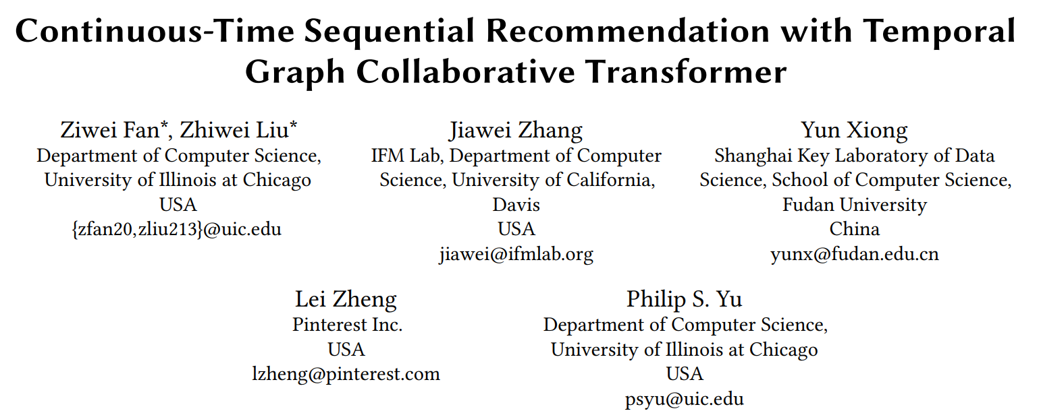

Slide 2
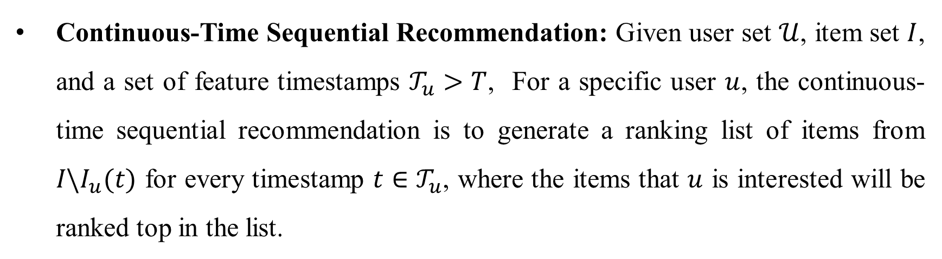
Problem Formulation
Continuous-Time Sequential Recommendation: Given user set $𝒰$, item set $I$, and a set of feature timestamps $𝒯_{u}>T$, For a specific user $u$, the continuous-time sequential recommendation is to generate a ranking list of items from $I\backslash I_{u}(t)$ for every timestamp $t∈𝒯_{u}$, where the items that $u$ is interested will be ranked top in the list.

Slide 3
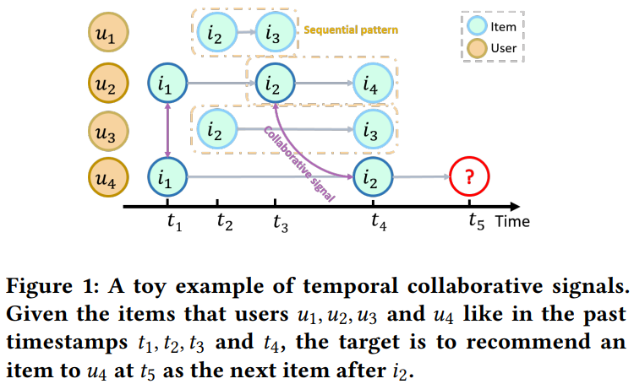
Motivation
How to encode collaborative signals and sequential patterns simultaneously?
How to express the temporal effects of collaborative signals effectively?

Slide 4
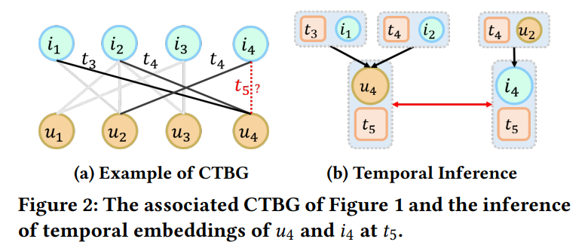
Continuous Time Bipartite Graph (CTBG)
Based on timestamps and neighbor items of user preserve sequential patterns, the CTBG is constructed for sequential patterns and collaborative signals unification.
Devising Temporal Collaborative Transformer (TCT) layer, which adopts collaborative attention among user-item interactions to capture temporal collaborative signals.

Slide 5
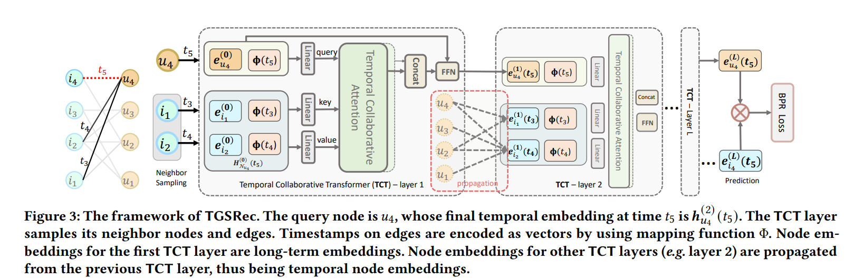
Temporal Graph Sequential Recommender (TGSRec)

Slide 6
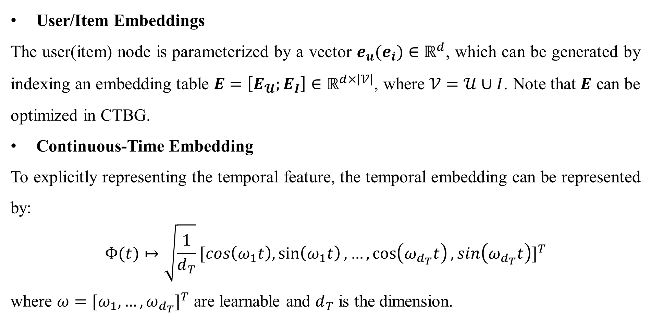
Embedding Layer
User/Item Embeddings
The user(item) node is parameterized by a vector $e_{u}(e_{i})∈ℝ^{d}$, which can be generated by indexing an embedding table $E=\left[E_{𝓤};E_{I}\right]∈ℝ^{d×\left|𝒱\right|}$, where $𝒱=𝒰∪I$. Note that $E$ can be optimized in CTBG.
Continuous-Time Embedding
To explicitly representing the temporal feature, the temporal embedding can be represented by:
$$Φ(t)↦\sqrt{\frac{1}{d_{T}}}{[cos\left(ω_{1}t\right),\sin\left(ω_{1}t\right),…,\cos\left(ω_{d_{T}}t\right),sin\left(ω_{d_{T}}t\right)]}^{T}$$
where $ω={[ω_{1},…,ω_{d_{T}}]}^{T}$ are learnable and $d_{T}$ is the dimension.

Slide 7
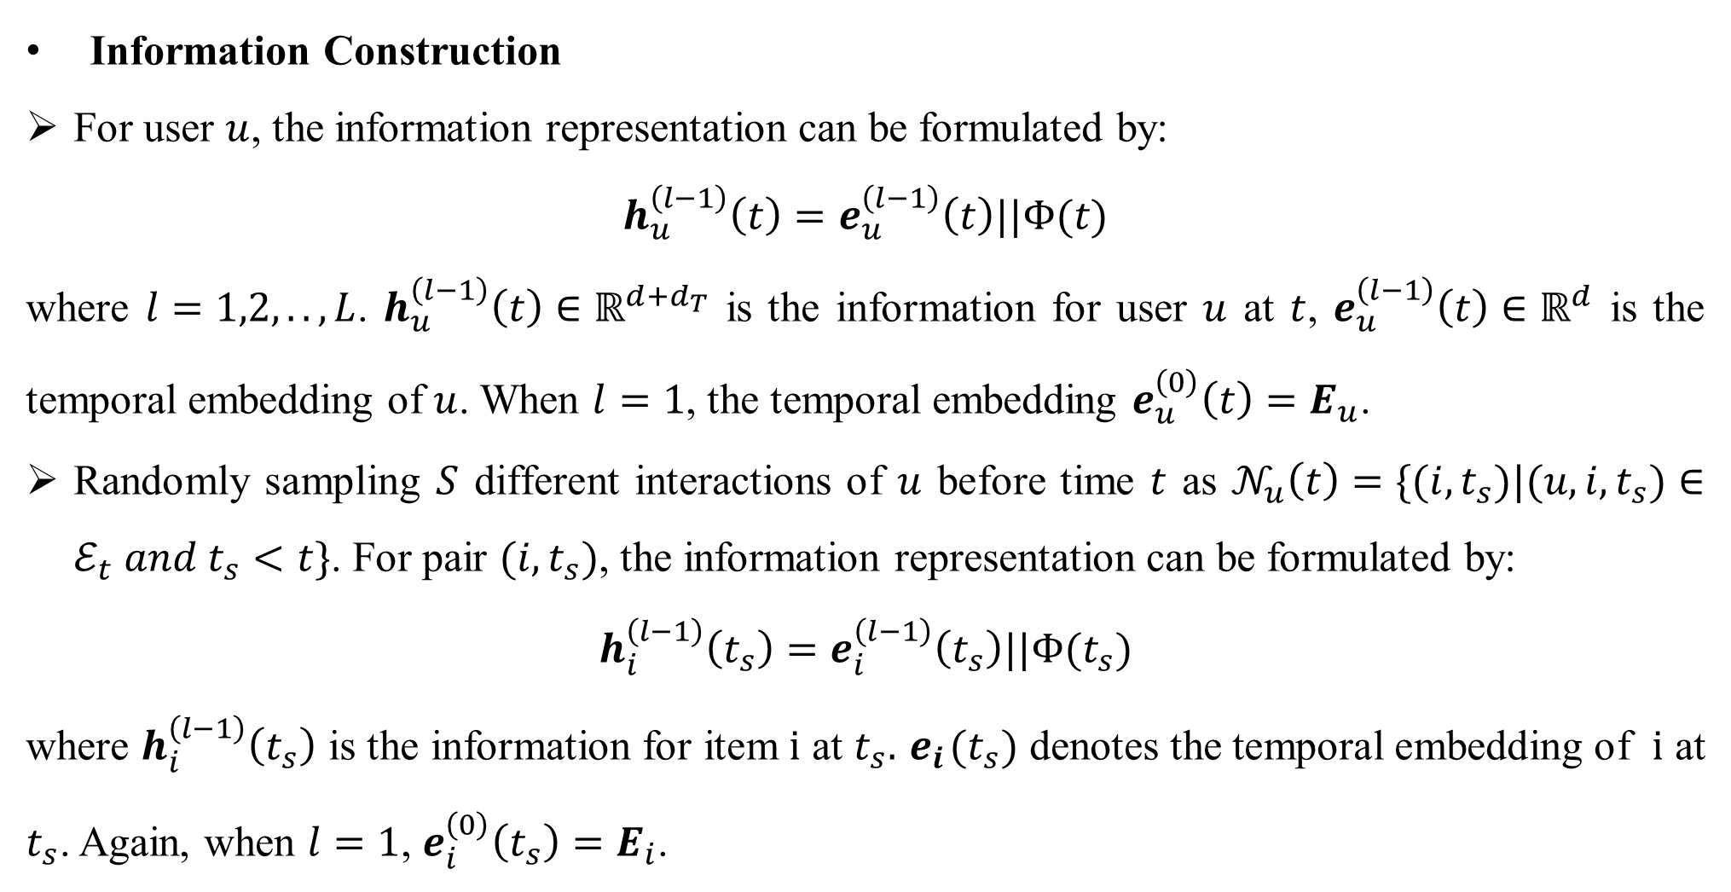
Temporal Collaborative Transformer
Information Construction
For user $u$, the information representation can be formulated by:
$$h_{u}^{\left(l−1\right)}\left(t\right)=e_{u}^{\left(l−1\right)}\left(t\right)||Φ(t)$$
where $l=1,2,..,L$. $h_{u}^{\left(l−1\right)}\left(t\right)∈ℝ^{d+d_{T}}$ is the information for user $u$ at $t$, $e_{u}^{\left(l−1\right)}\left(t\right)∈ℝ^{d}$ is the temporal embedding of $u$. When $l=1$, the temporal embedding $e_{u}^{\left(0\right)}\left(t\right)=E_{u}$.
Randomly sampling $S$ different interactions of $u$ before time $t$ as $𝒩_{u}\left(t\right)=\{(i,t_{s})|(u,i,t_{s})∈ℰ_{t} and{ t}_{s}<t\}$. For pair $(i,t_{s})$, the information representation can be formulated by:
$$h_{i}^{\left(l−1\right)}\left(t_{s}\right)=e_{i}^{\left(l−1\right)}\left(t_{s}\right)||Φ(t_{s})$$
where $h_{i}^{\left(l−1\right)}\left(t_{s}\right)$ is the information for item $i$ at $t_{s}.{ e}_{i}(t_{s})$ denotes the temporal embedding of $i$ at $t_{s}$. Again, when $l=1$, $e_{i}^{\left(0\right)}\left(t_{s}\right)=$ $E_{i}$.

Slide 8
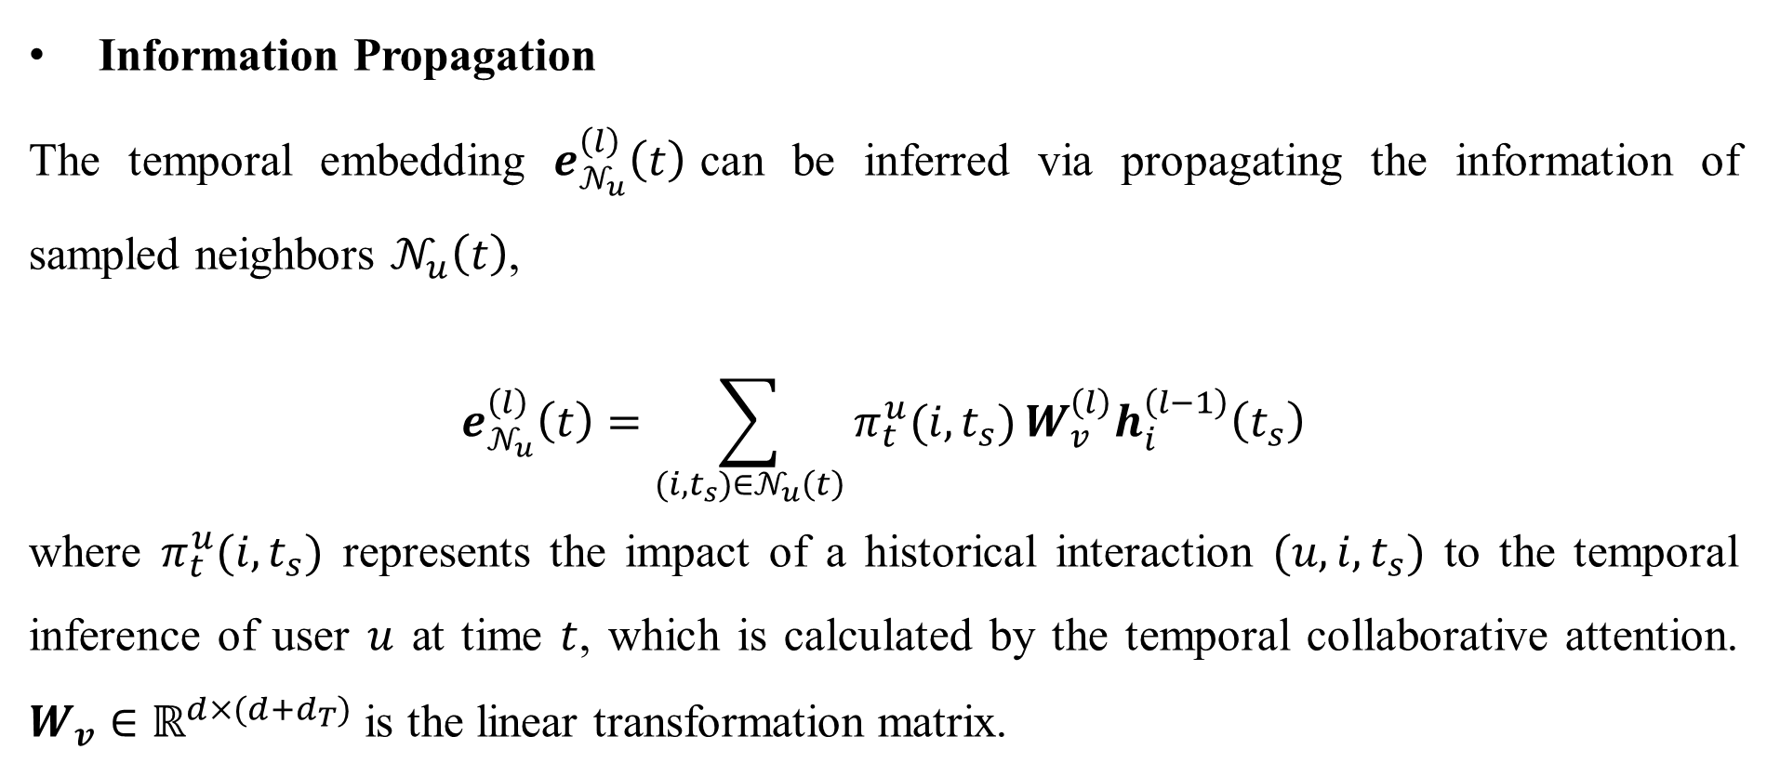
Temporal Collaborative Transformer
Information Propagation
The temporal embedding $e_{𝒩_{u}}^{\left(l\right)}\left(t\right)$can be inferred via propagating the information of sampled neighbors $𝒩_{u}\left(t\right)$,
$$e_{𝒩_{u}}^{\left(l\right)}\left(t\right)=\sum_{(i,t_{s})∈𝒩_{u}\left(t\right)}{π_{t}^{u}(i,t_{s})}W_{v}^{\left(l\right)}h_{i}^{\left(l−1\right)}\left(t_{s}\right)$$
where $π_{t}^{u}(i,t_{s})$ represents the impact of a historical interaction $(u,i,t_{s})$ to the temporal inference of user $u$ at time $t$, which is calculated by the temporal collaborative attention. $W_{v}∈ℝ^{d×(d+d_{T})}$ is the linear transformation matrix.

Slide 9
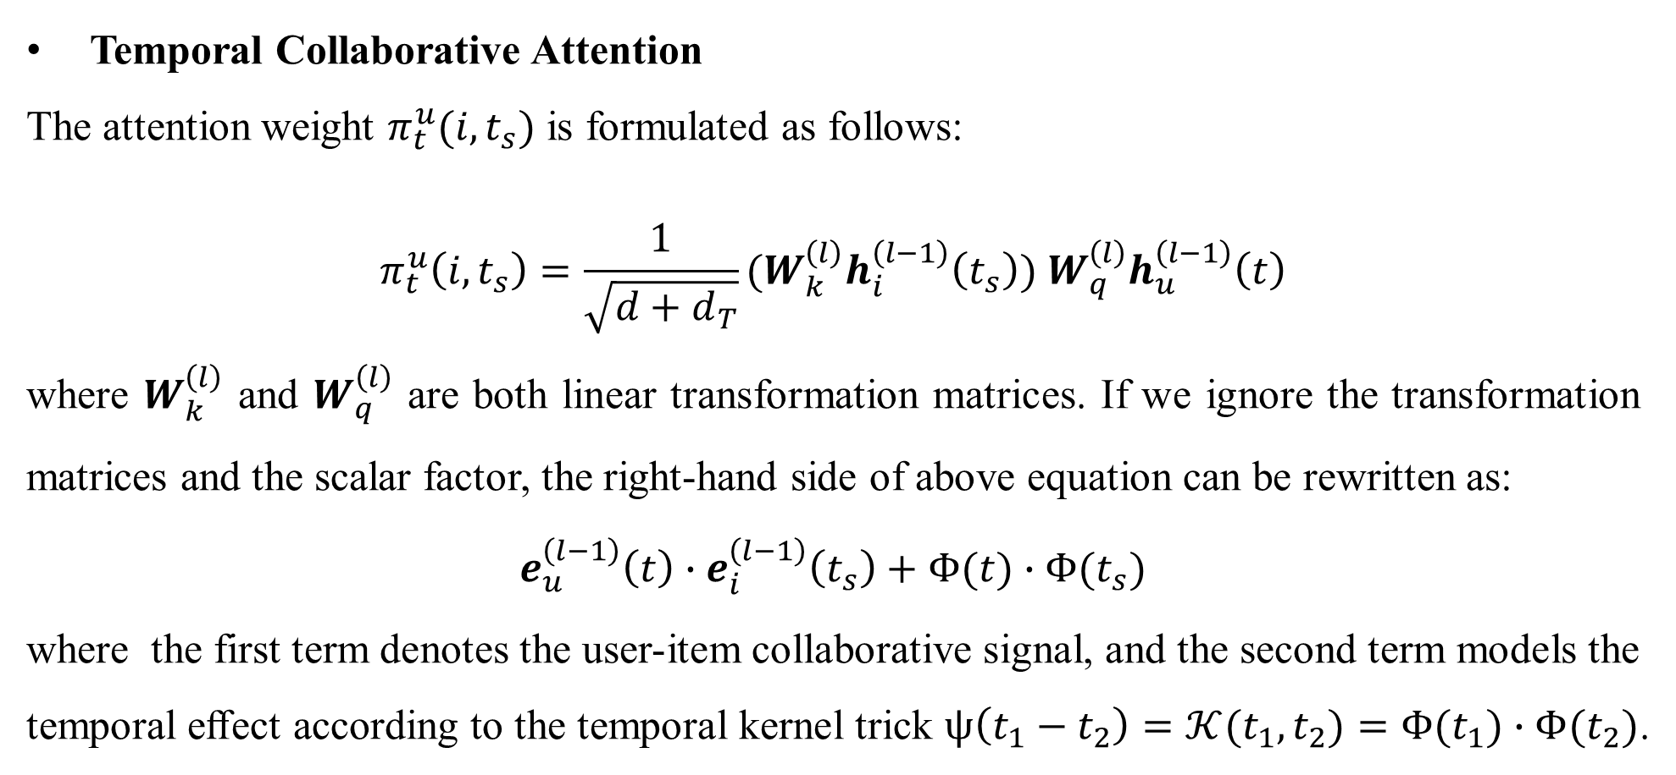
Temporal Collaborative Transformer
Temporal Collaborative Attention
The attention weight $π_{t}^{u}(i,t_{s})$ is formulated as follows:
$$π_{t}^{u}\left(i,t_{s}\right)=\frac{1}{\sqrt{d+d_{T}}}(W_{k}^{\left(l\right)}h_{i}^{\left(l−1\right)}\left(t_{s}\right)) W_{q}^{\left(l\right)}h_{u}^{\left(l−1\right)}\left(t\right)$$
where $W_{k}^{\left(l\right)}$ and $W_{q}^{\left(l\right)}$ are both linear transformation matrices. If we ignore the transformation matrices and the scalar factor, the right-hand side of above equation can be rewritten as:
$$e_{u}^{\left(l−1\right)}\left(t\right)∙e_{i}^{\left(l−1\right)}\left(t_{s}\right)+Φ(t)∙Φ(t_{s})$$
where the first term denotes the user-item collaborative signal, and the second term models the temporal eﬀect according to the temporal kernel trick $ψ\left(t_{1}−t_{2}\right)=𝒦(t_{1},t_{2})=Φ(t_{1})∙Φ(t_{2})$.

Slide 10
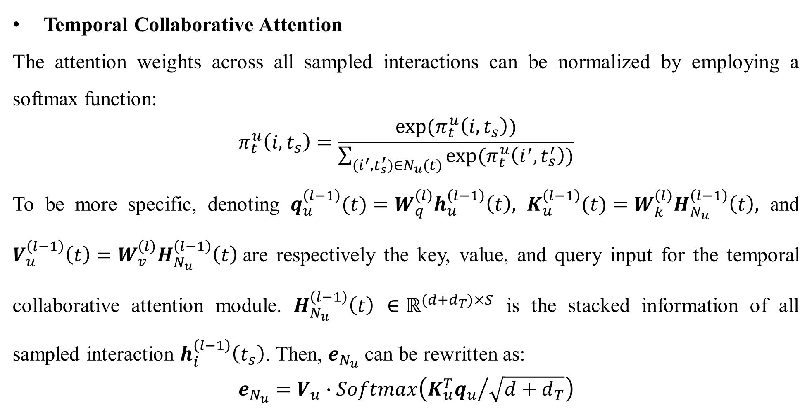
Temporal Collaborative Transformer
Temporal Collaborative Attention
The attention weights across all sampled interactions can be normalized by employing a softmax function:
$$π_{t}^{u}\left(i,t_{s}\right)=\frac{exp⁡(π_{t}^{u}\left(i,t_{s}\right))}{\sum_{(i^{′},t_{s}^{′})∈N_{u}(t)}{exp⁡(π_{t}^{u}\left(i^{′},t_{s}^{′}\right))}}$$
To be more specific, denoting $q_{u}^{\left(l−1\right)}(t)=W_{q}^{\left(l\right)}h_{u}^{\left(l−1\right)}\left(t\right),$ $K_{u}^{\left(l−1\right)}(t)=W_{k}^{\left(l\right)}H_{N_{u}}^{\left(l−1\right)}\left(t\right),$ and $V_{u}^{\left(l−1\right)}\left(t\right)=W_{v}^{\left(l\right)}H_{N_{u}}^{\left(l−1\right)}\left(t\right)$are respectively the key, value, and query input for the temporal collaborative attention module. $H_{N_{u}}^{\left(l−1\right)}\left(t\right)$ $∈ℝ^{(d+d_{T})×S}$ is the stacked information of all sampled interaction $h_{i}^{\left(l−1\right)}\left(t_{s}\right)$. Then, $e_{N_{u}}$can be rewritten as:
$$e_{N_{u}}=V_{u}∙Softmax\left({K_{u}^{T}q_{u}}/{\sqrt{d+d_{T}}}\right)$$

Slide 11
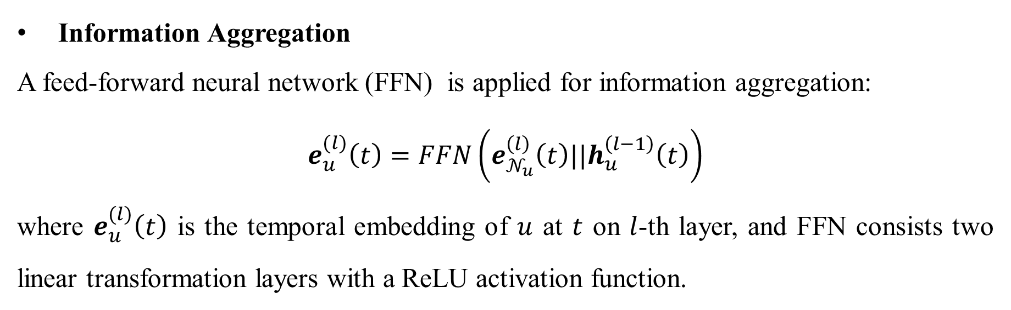
Temporal Collaborative Transformer
Information Aggregation
A feed-forward neural network (FFN) is applied for information aggregation:
$$e_{u}^{(l)}\left(t\right)=FFN\left(e_{𝒩_{u}}^{\left(l\right)}\left(t\right)||h_{u}^{\left(l−1\right)}\left(t\right)\right)$$
where $e_{u}^{(l)}\left(t\right)$ is the temporal embedding of $u$ at $t$ on $l$-th layer, and FFN consists two linear transformation layers with a ReLU activation function.

Slide 12
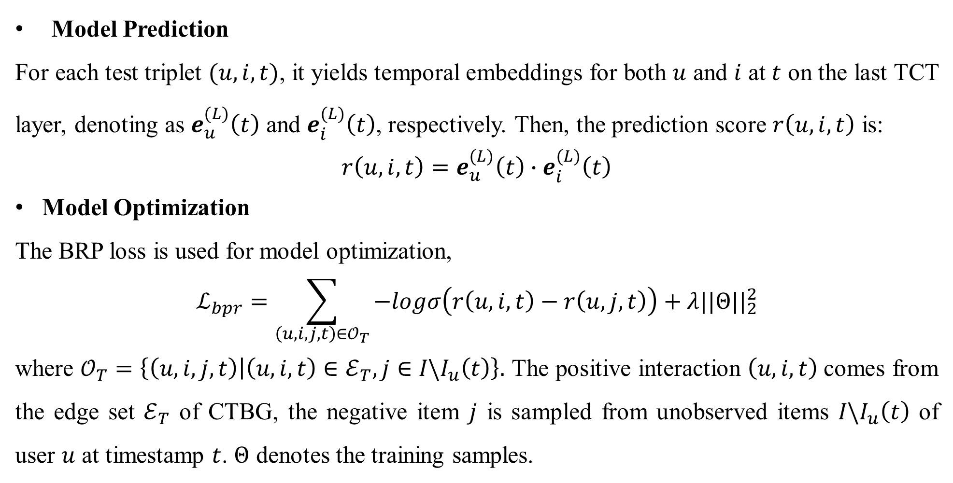
Model Prediction and Optimization
Model Prediction
For each test triplet $(u,i,t)$, it yields temporal embeddings for both $u$ and $i$ at $t$ on the last TCT layer, denoting as $e_{u}^{(L)}\left(t\right)$ and $e_{i}^{(L)}\left(t\right)$, respectively. Then, the prediction score $r\left(u,i,t\right)$ is:
$${r\left(u,i,t\right)=e}_{u}^{(L)}\left(t\right)∙e_{i}^{(L)}\left(t\right)$$
Model Optimization
The BRP loss is used for model optimization,
$$ℒ_{bpr}=\sum_{\left(u,i,j,t\right)∈𝒪_{T}}{−logσ\left(r\left(u,i,t\right)−r\left(u,j,t\right)\right)+λ{||Θ||}_{2}^{2}}$$
where $𝒪_{T}=\left\{\left(u,i,j,t\right) | \left(u,i,t\right)∈ℰ_{T},j∈I\backslash I_{u}\left(t\right)\right\}.$ The positive interaction $\left(u,i,t\right)$comes from the edge set $ℰ_{T}$ of CTBG, the negative item $j$ is sampled from unobserved items $I\backslash I_{u}\left(t\right)$ of user $u$ at timestamp $t$. $Θ$ denotes the training samples.

Slide 13
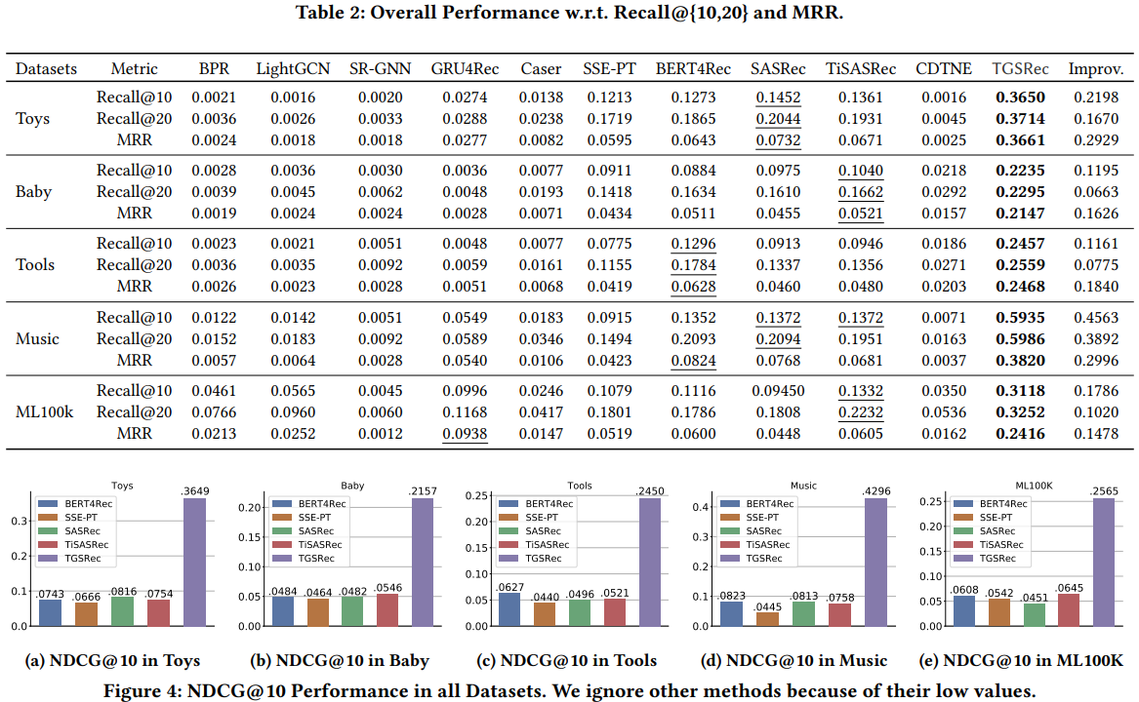
Experiments

Slide 14
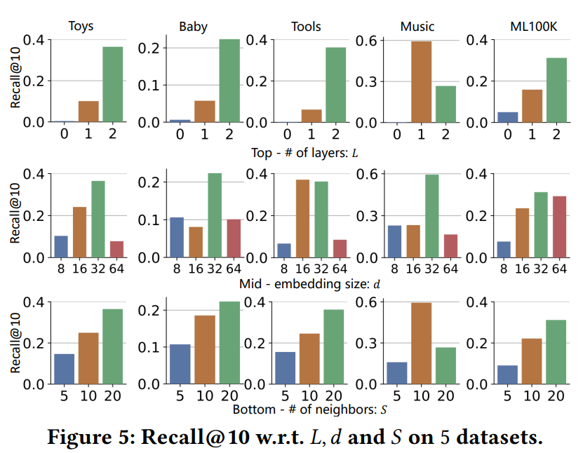
Experiments

Slide 15
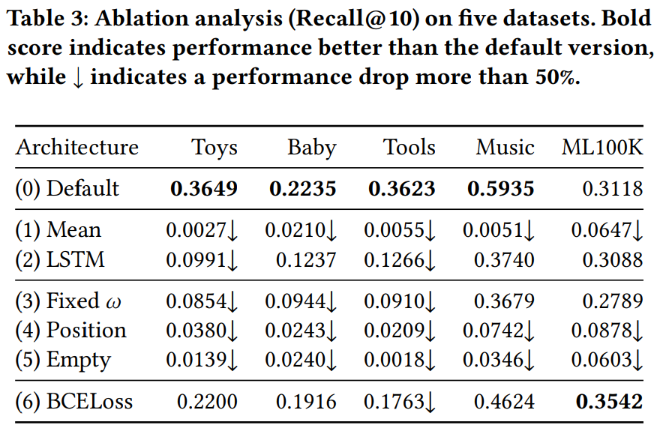
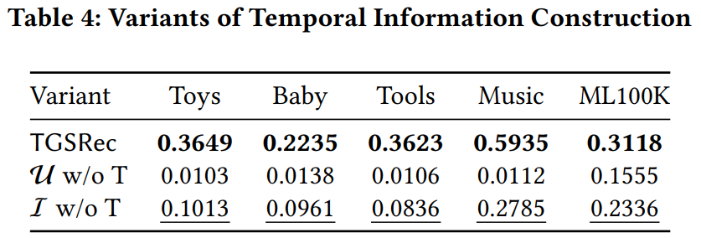
Experiments

